Slide 1
Hydrological Information System
Module – Data Collection Platform
Anish
….. Consultant, Hydro-Informatics
The World Bank

Slide 2
Examples that refer to products are intended for illustrative purposes only, and do not imply an endorsement or recommendation of any particular product

Slide 3
General Features
Central and Most Important part of Telemetric Station
Functions
Supplies Power to Sensors,
Reads and record data
Pass on data to telemetry unit for transmission
Highly configurable based on requirements
Some Models available with inbuilt GSM transmitter
Some Data loggers are integral part of Sensor
Data Logger

Slide 4
Common Features of Data Loggers
Screen to view/alter data and configure devices
Very low power consumption
Multiple communication ports for simultaneous data relay (GSM/GPRS, INSAT, VSAT)
Analog, Digital, RS-232, SDI-12 Data Inputs
Digital, RS-232 outputs
Frequency of collection/logging can be different for each sensor
Logging/Transmissions can be triggered based on a measured event

Slide 5
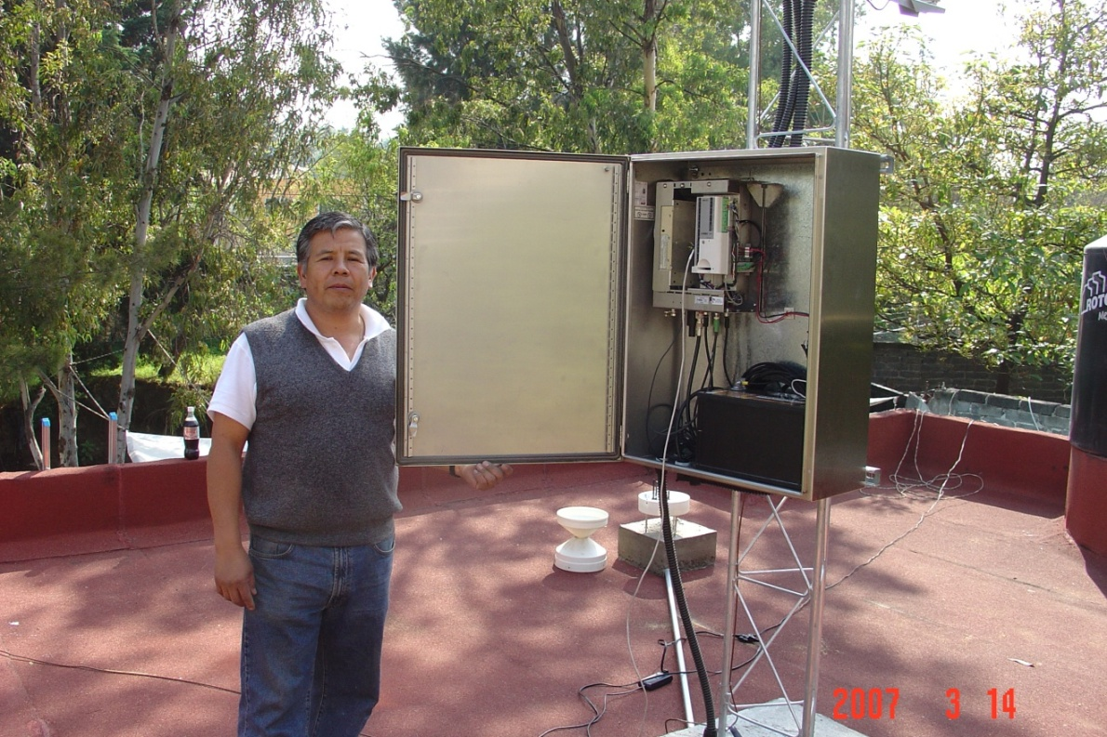
Data Loggers
Concept
Data loggers interrogate sensors and store data at hydromet stations
Often coupled with telemetry devices for transmitting data from remote sites to central data management center
Data loggers can trigger and record measurements at any set time
This includes all digital and analog hydrological and meteorological sensors
Other measured parameters include solar panel input and battery voltage used by technical personnel

Slide 6
Common Features of Advanced Data Loggers
Ability to switch on/off power to sensors (power saving concept)
No data loss upon power loss
Automatic start up when power is restored
Program upload feature
Can calculate and store values based on sensor inputs

Slide 7
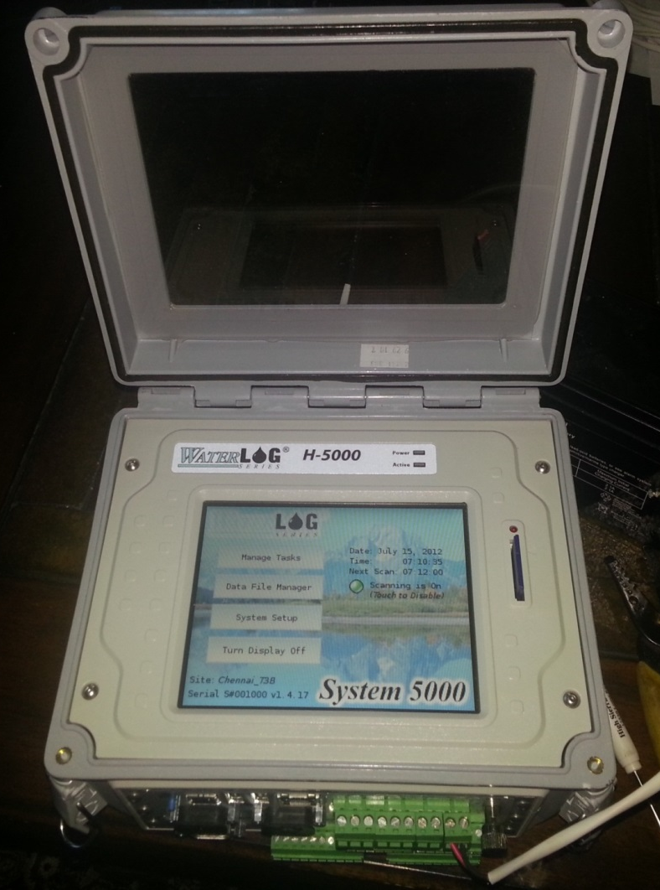
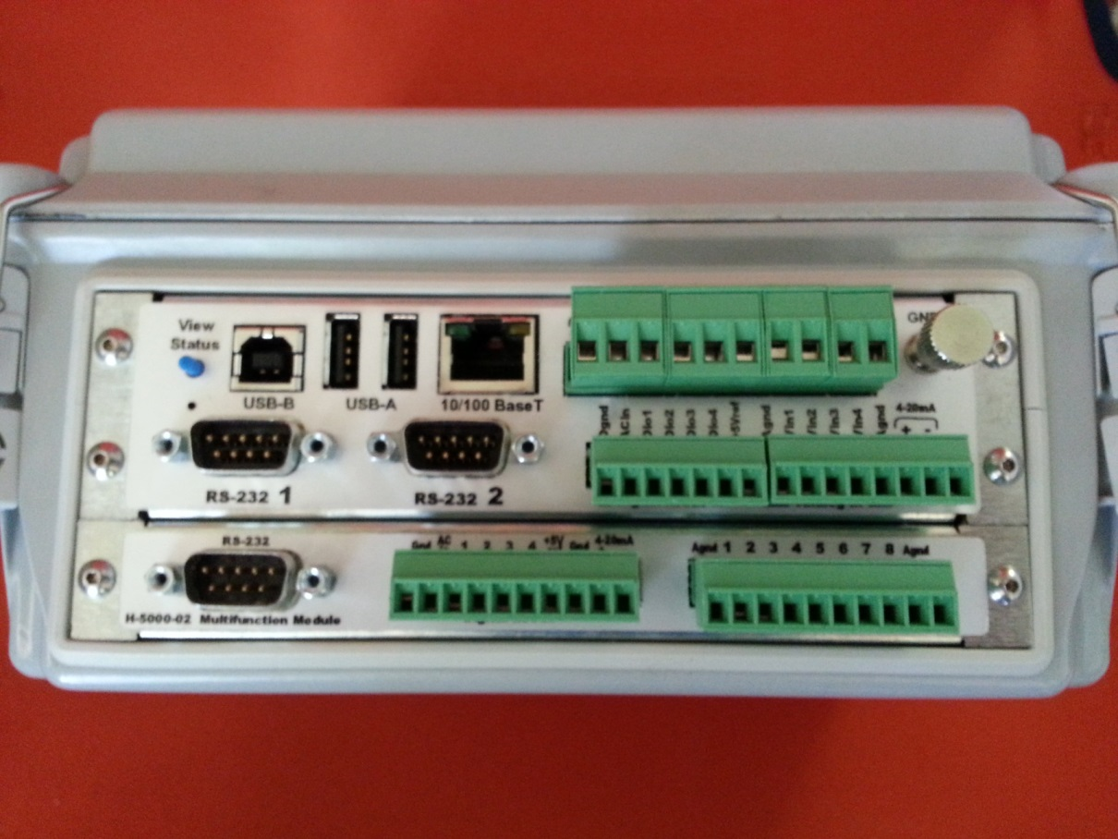
EXAMPLES OF DATALOGGERS

Slide 8
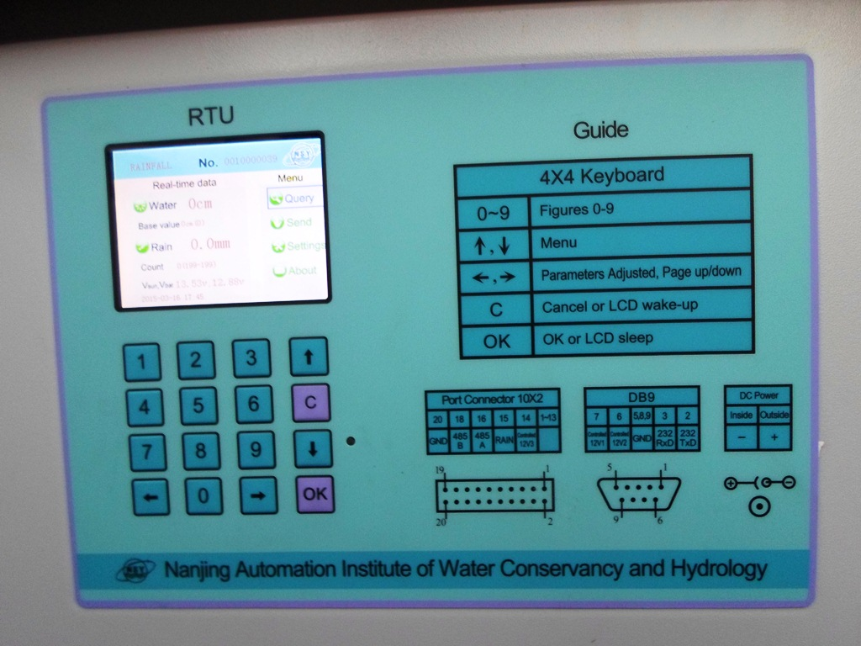
Data logger - Examples
Data Logger
Nanjing Datalogger with Customized display for Water level and Rain; Bhubaneswar

Slide 9
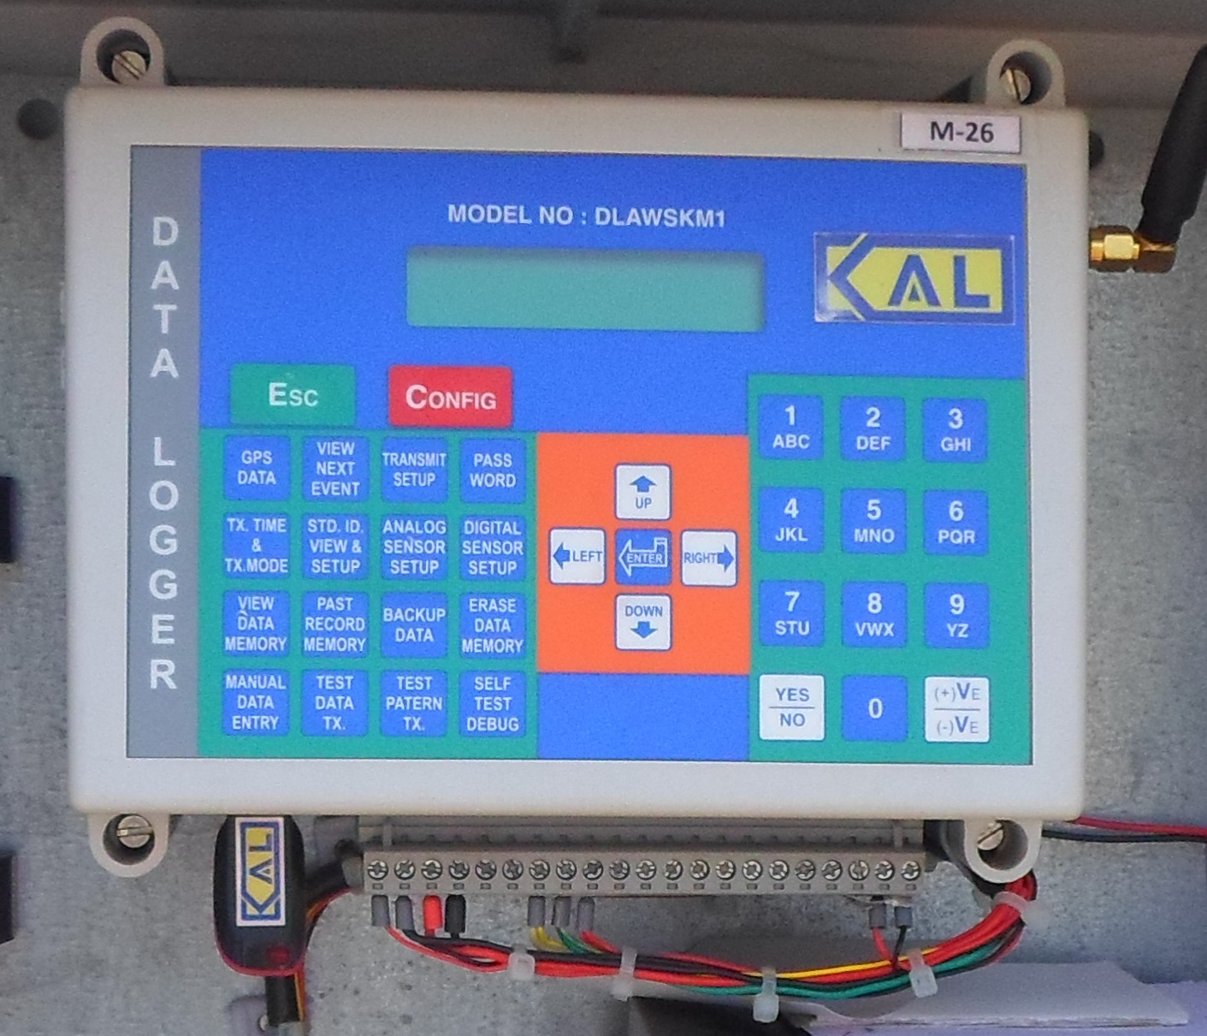
Data logger - Examples
Data Logger
Komoline Data logger with inbuilt GSM Transmitter, Ahmedabad

Slide 10
Data logger - Examples
Data Logger
Installed in 2001, Still working Perfect!
Data logger as part of Shaft Encoder with internal battery, Gandhi Nagar, Gujarat

Slide 11
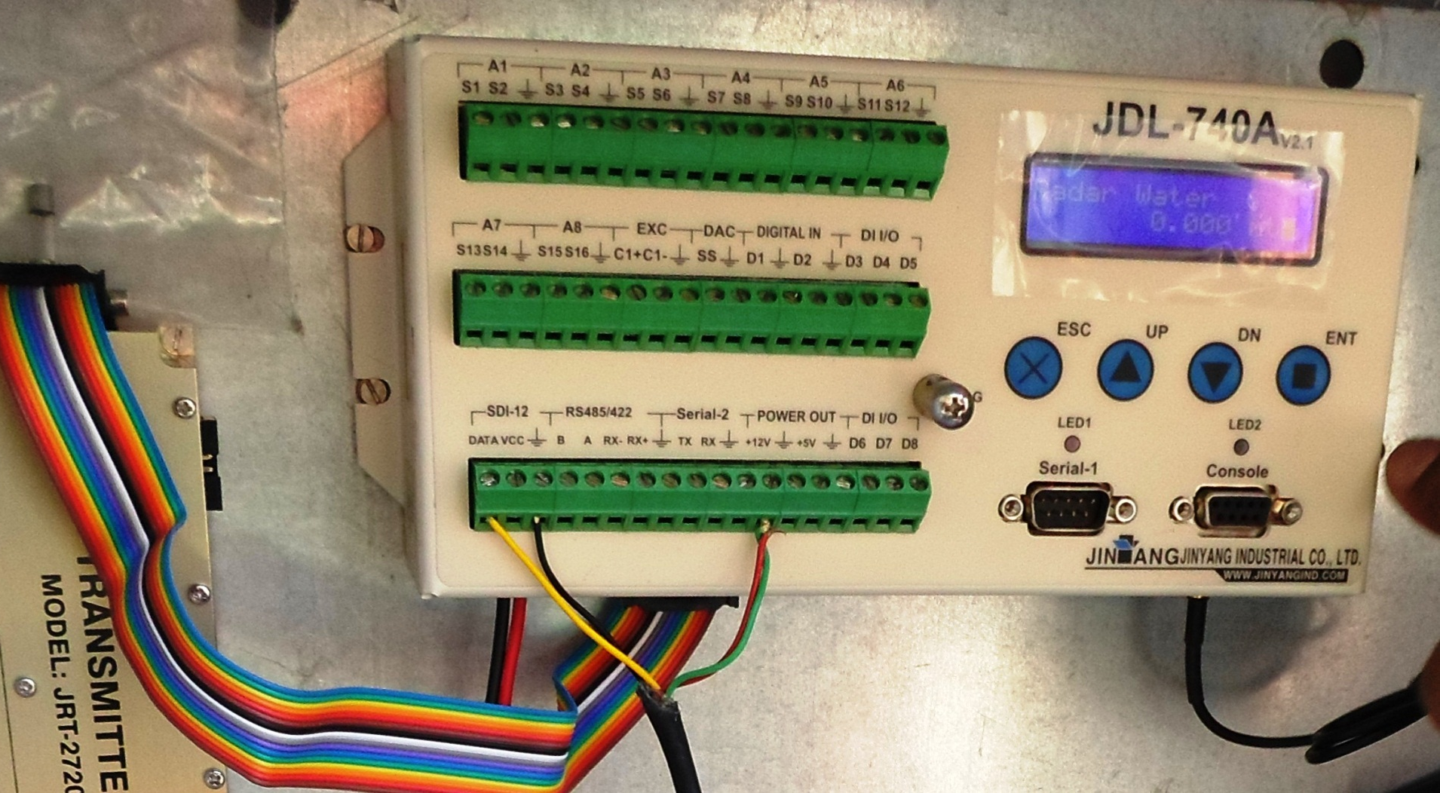
Data logger - Examples
Data Logger
Jinyang Data logger showing input, output and communication ports, Kapla, Himachal Pradesh

Slide 12
Data logger - Examples
Sutron Data Logger with in built Satellite Transmitter
Sutron Data Logger with inbuilt Satellite Transmitter, Display and Keypad
Data Logger

Slide 13
Data Logger Specifications
Sensor Interface
8 analogue channels
8 digital input/output channels, 2 input for rain gauge impulses, 6 bidirectional
Minimum 1 serial port for digital input SDI-12
Input/output interfaces
One for the INSAT radio
One for the addition of GSM radio
One Serial Port (RS232) for communication with Laptop or programming
USB Stick option for Data transfer
Data Logger

Slide 14
Data Logger Specifications
Flash memory minimum 32 mb
Non-volatile flash memory
A/D resolution ≥16 bit
Individual recording intervals for each sensor/parameter
Multi-tasking operating system - must log data and transmit at same time
Digital Display for viewing current data and setting values
Power supply 12V DC, low current drain (quiescent ≤10.0mA)
Monitoring of battery voltage level
internal battery backup for clock
Data Logger

Slide 15
Data Logger Specifications
Software
Windows software for system configuration / communication
English language version
All required licenses included
Different user levels, system of user rights / passwords, access restricted to authorized personnel
Data Logger

Slide 16
Introduction
The telemetry Device transmits data to central server location
Can provide One-Way or Two Way Communication
One Way – Push method
Two Way – Push and Pull Method
The communication medium can be:
GSM Towers
Satellites
INSAT Radio Transmitter
VSAT
Telemetry

Slide 17
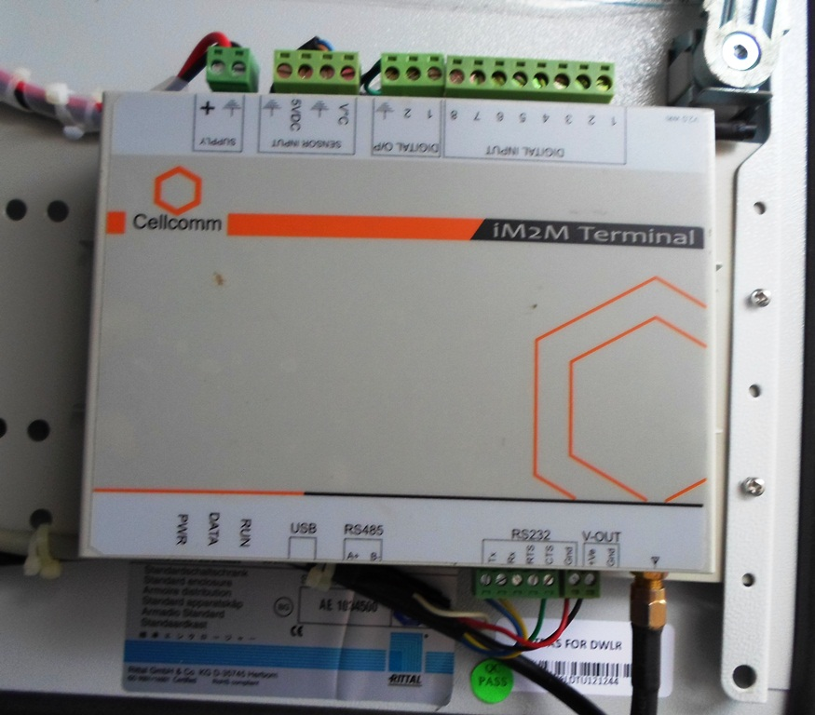
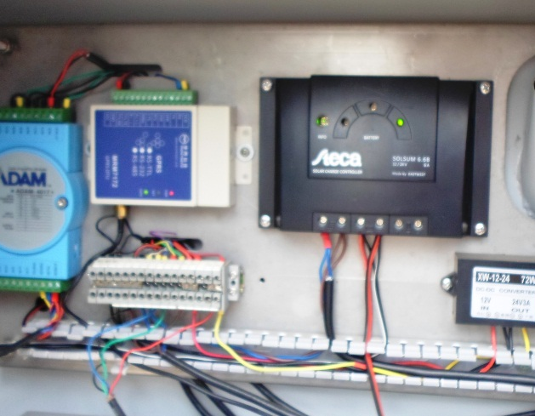
GSM Based Telemetry
The Telemetry device has SIM card
Can transmit via SMS or GPRS internet
Telemetry Device can be:
Telemetry
Integral part of Data logger
Separate Device

Slide 18
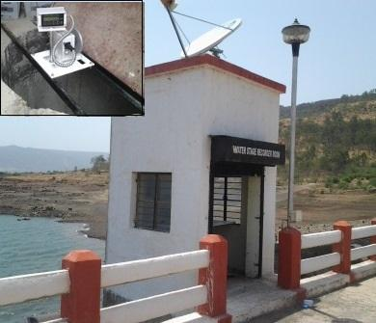
Satellite Based Telemetry
Telemetry
VSAT based two way communication
INSAT based one way communication
Finer Details of Telemetry are covered in Telemetry Module

Slide 19
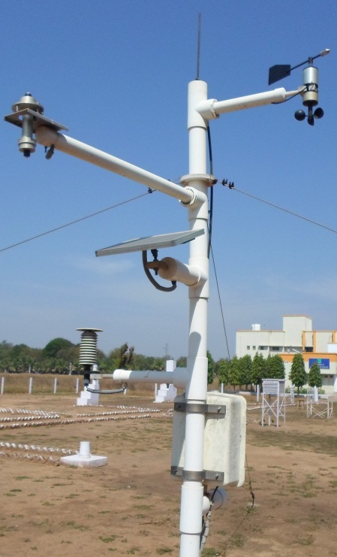
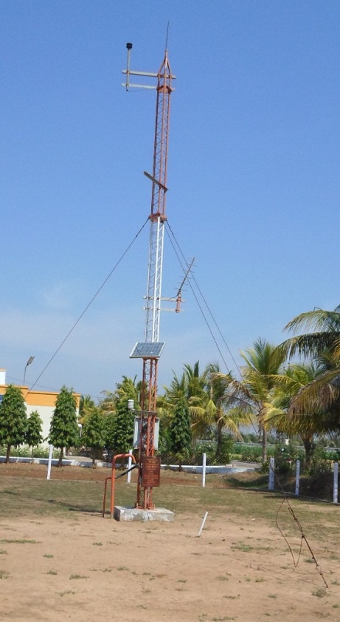
Masts
Masts should be Sturdy, rust proof
Installed on good concrete foundation
Should not vibrate with wind
Installation

Slide 20
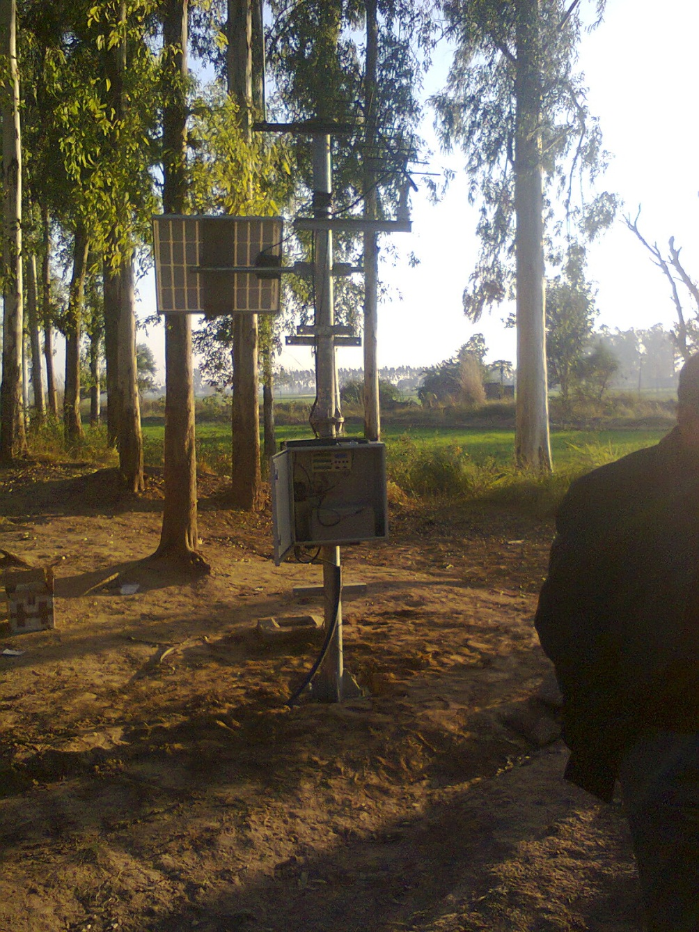
Solar Panels
Installation
What is wrong here?
Solar Panel in Shadow of Trees

Slide 21
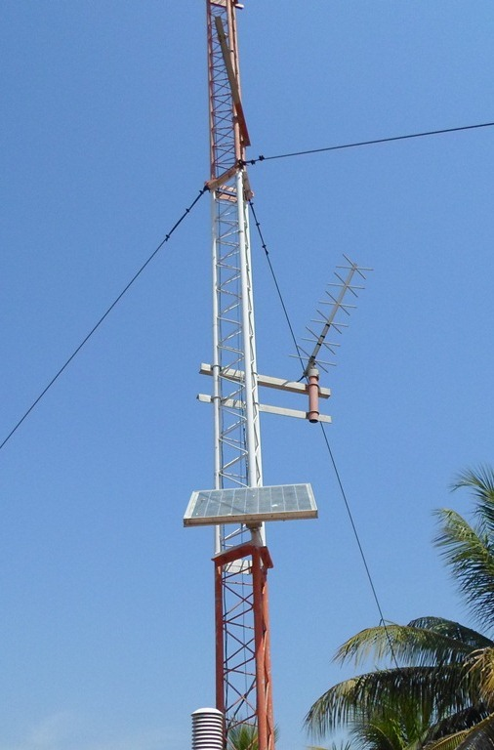
Solar Panels
Installation
Chitkul, Himachal Pradesh
Anand, Gujarat

Slide 22
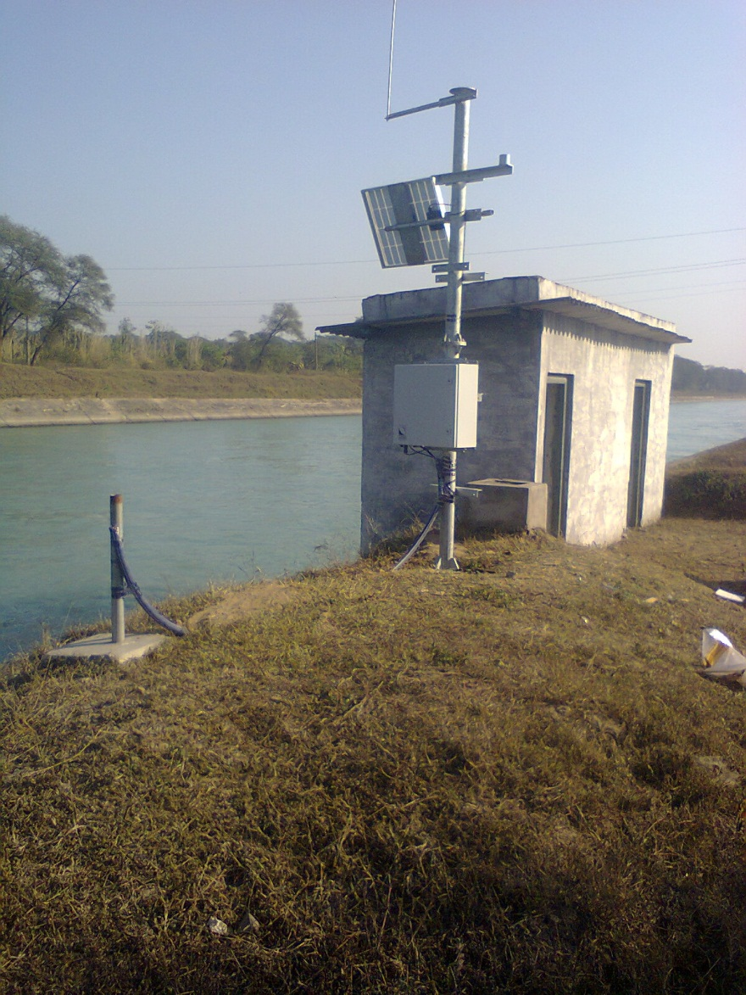
Solar Panel
Almost Vertical in Himachal
Almost Horizontal in Gujarat
Installation
What should be Right Direction?
What is major difference in solar Panel Installation?

Slide 23
Solar Panel - Direction
In Northern Hemisphere, Solar Panel always faces South
This maximizes sunlight, specially during winter
The tilt angle w.r.t. ground should be equal to Latitude of Location
Horizontal (0 degree tilt) at Equator
30-35 degree for northern states
Installation

Slide 24
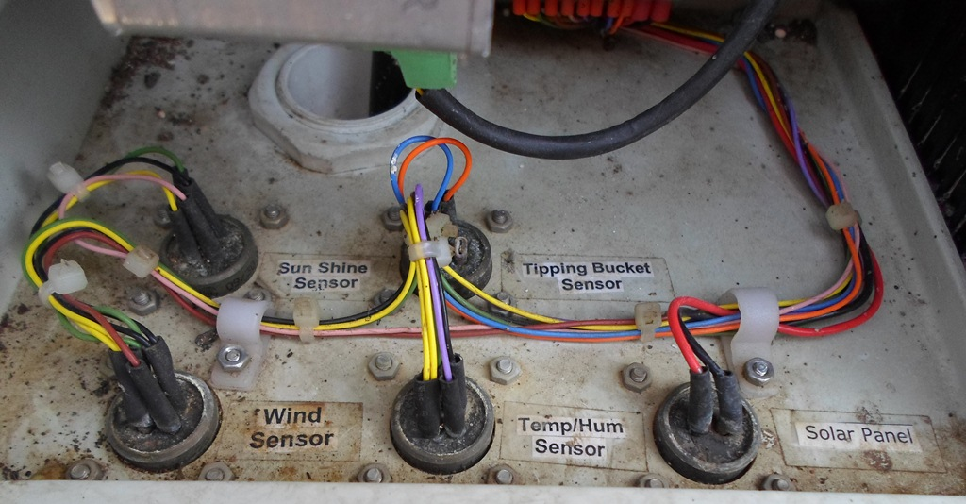
Connections and Wires
Installation
Label the Connection wires if feasible

Slide 25
Specifications
What should it cover
Goods
Services
Warranty
Operation and Maintenance

Slide 26
Technical Specifications
Details to be included
Not too less, not Too much
Maps and Drawings
GIS locations of Installation

Slide 27
Specifications - Elements
Description of the Area
What you have and what you need
Ambient Site Conditions
Scope of Works
Bidder’s Responsibilities
Purchaser’s Responsibilities
Delivery and Completion Schedule
Training Requirements
Personnel Requirements

Slide 28
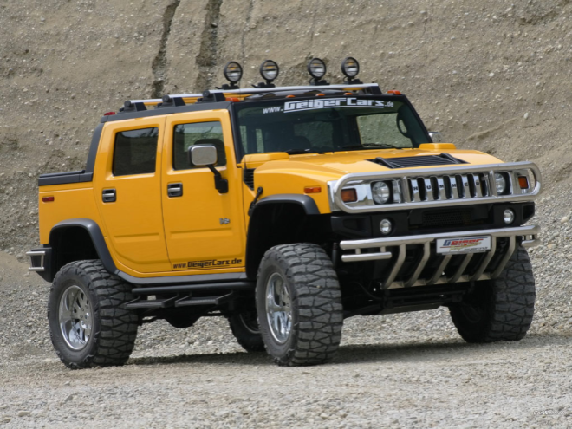
Technical Specifications
Technology and Parameters
What we need
What we Demand
What we get

Slide 29
Specifications of Goods
Instrument Specifications
Functional / Operational Parameters
Physical Parameters
Support Parameters
Spare parts and manuals
Accessories and Tools

Slide 30
Specifications of Services
Field Visits
Civil Works
Fencing
Wiring and Enclosures

Slide 31
Software
Functional Requirements
Licenses
Compatibility with Existing System
Data Formats
Units

Slide 32
Operation and Maintenance
O&M of complete System
Response time for repairs
Response time for replacements

Slide 33
General Specifications
Ambient Site Condition
Humidity Range – 5 to 100%
Temperature Range –
-20 to +60 Degree for plain areas
-40 to +40 Degree for Himalayan Regions
Altitude –
300 to 3000 meter for Himalayan Regions
0 to 1000 meter for other regions
Enclosures – Outdoor Antirust and dust-free
Protection - NEMA 4 or IP65
Specifications

Slide 34
Enclosures
Specifications

Slide 35
General Specifications
Radiation shield of double wall
All connections and wires should be concealed
Lightning protection – All equipment to be surge protected
Fencing – Chain link fence with barbed wire
All Accessories, tools, fixtures required for installation and operation
Specifications

Slide 36
General Specifications
User Manuals – Complete manuals in English
Operation and Maintenance manuals
Complete Manuals including Wiring Diagrams
System Block Diagrams
Power Consumption
Low Power consumption with standby option
GPS for time synchronization
Power Supply – Enough to last for 6 days of operation without charging
Specifications

Slide 37
Thank You

